Slide 1
Triangulation Using Computer Vision
Cot5930: Introduction to Robotics
Dr. Ravi Shankar
By
Huajin Ariel Qu & Charles Perry Weinthal

Slide 2
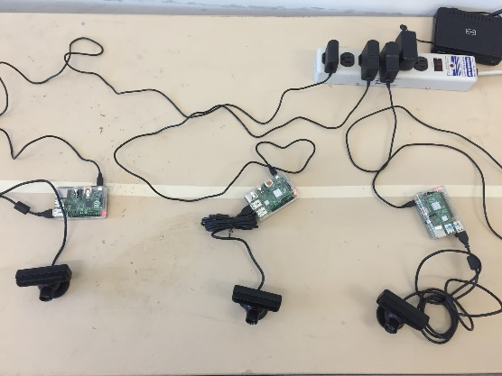
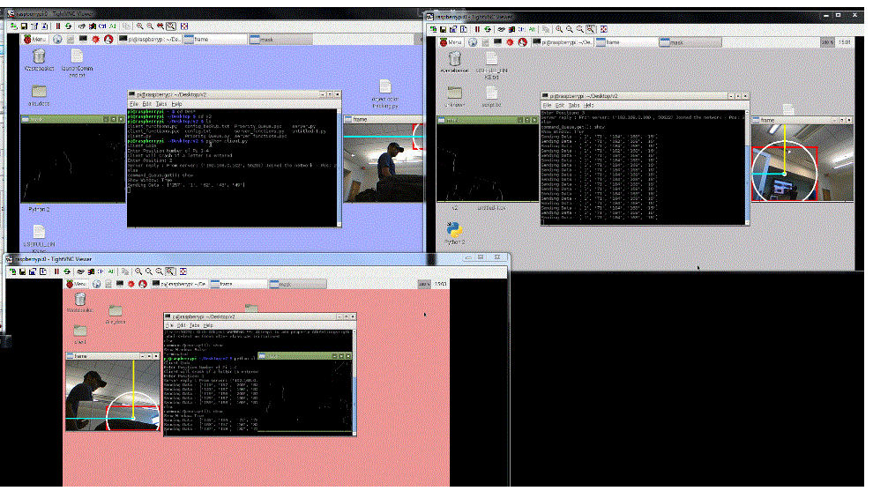
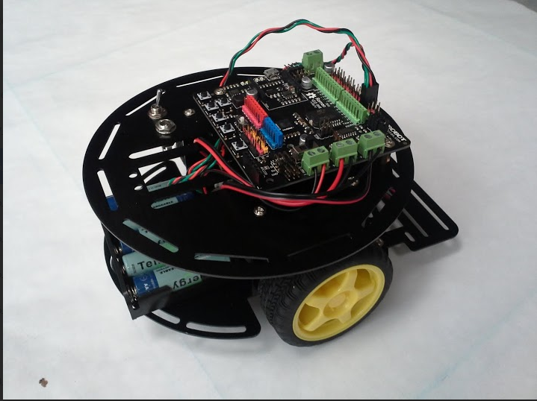
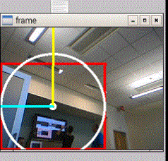
Overview
Four Raspberry Pi have been configured with USB WebCams to view the movement grid, these four units then report via WiFi connections to a main computational and control Unit. The main unit will then compute the distance using triangulation and command the Robot to move via a Bluetooth interface.

Slide 3



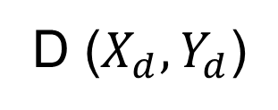

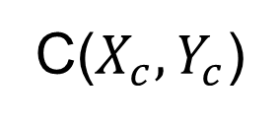
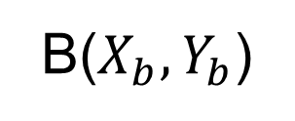
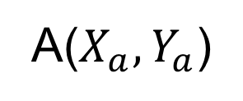
Where is the Robot?
C($X_{c},Y_{c}$)
B($X_{b},Y_{b}$)
$$α2$$
c
b
$$α3$$
(x,y)
Cameras are
located at
A, B, C, D
$$α1$$
a
d
$$α4$$
A($X_{a},Y_{a}$)
D ($X_{d},Y_{d}$)

Slide 4

Triangulation Formulas
$$x={±X}_{camera}±D∗f\left(α\right)$$
$$y={±Y}_{camera}±D∗g\left(α\right)$$
$$D=\left(a,b,c,d\right)$$
For Camera A & C: $f\left(α\right)=sinα :g(α)= cosα$
For Camera B & D: $f\left(α\right)=cosα :g(α)=sinα$
$x=$ $X_{a}+a sinα_{1} : y= Y_{a}+a cosα_{1}$
$x=$ $X_{b}+b cosα_{2} : y= Y_{b}−b sinα_{2}$
$x=$ $X_{c}−c sinα_{3} : y= Y_{c}−c cosα_{3}$
$x=$ $X_{d}−d cosα_{4} : y={ Y}_{d}\text{ + }\text{d} sinα_{4}$

Slide 5
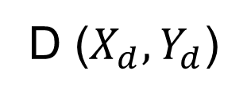
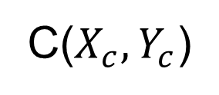
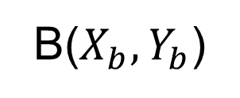
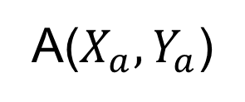

Current Camera View
B($X_{b},Y_{b}$)
C($X_{c},Y_{c}$)
Cameras are
located at
A, B, C, D
Inside the arc is the linear zone.
The angles are the vision boundaries.
$$l$$
A($X_{a},Y_{a}$)
D ($X_{d},Y_{d}$)

Slide 6

Choose the Best Camera for Your Solution
Only a few cameras will be in position to satisfy:
$$0≤\left(a,b,c,d\right)≤{\text{Distance}}_{l_r}$$
${\text{Distance}}_{l_r}$ = camera’s linear range
$$min≤\left(α_{1},α_{2},α_{3},α_{4}\right)≤max$$

Slide 7
Error Analysis
We generated the data to simulate the Distances and Angles given by four cameras;
The Robot locations were calculated by the formula given in previous slides;
The average errors were mapping in the following plot:

Slide 8
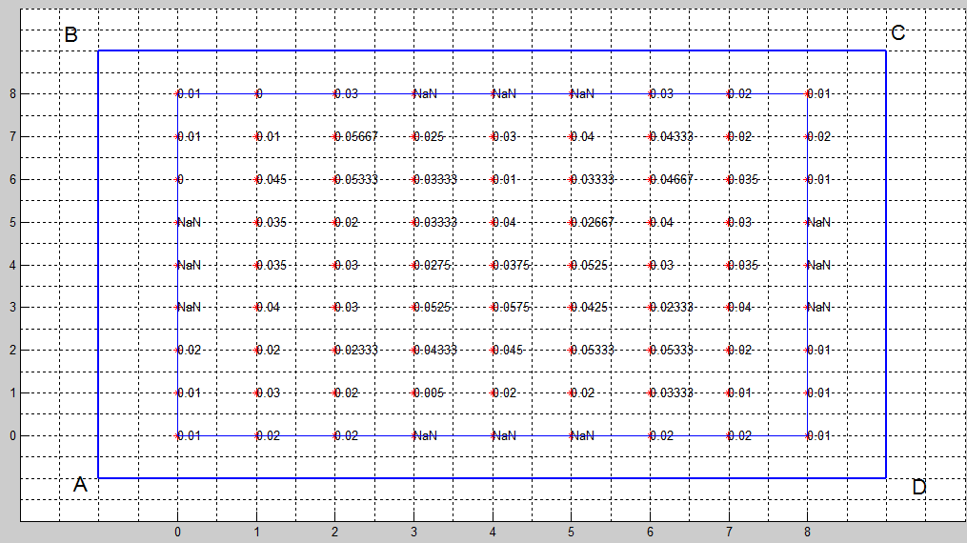
The infinite number is the “blind spot”, as we assumed the longer the distance the bigger the error, locations that are closer to cameras get smaller errors.
Error Analysis, cont’d

Slide 9
Error Analysis & Confidence in the Data Using MathLab:
% summerize:
C=[-1,-1,9,9,-1,9,9,-1]; %camera location
%actual distancen and angle with respect to four cameras
D=[a,b,c,d]
A=[angle1*180/pi,angle2*180/pi,angle3*180/pi,angle4*180/pi]
% add some error for the distance. the farther, the larger error
a_e=randi([-round(a),round(a)]);
b_e=randi([-round(b),round(b)]);
c_e=randi([-round(c),round(c)]);
d_e=randi([-round(d),round(d)]);
D_e=[a+0.01*a_e,b+0.01*b_e,c+0.01*c_e,d+0.01*d_e]
%estimated location from calculation:
x1=-1+D_e(1)*sind(A(1)); y1=-1+D_e(1)*cosd(A(1));
x2=-1+D_e(2)*cosd(A(2));y2=9-D_e(2)*sind(A(2));
x3=9-D_e(3)*sind(A(3));y3=9-D_e(3)*cosd(A(3));
x4=9-D_e(4)*cosd(A(4));y4=-1+D_e(4)*sind(A(4));
R_x=[x1,x2,x3,x4]
R_y=[y1,y2,y3,y4]
e_p=[sqrt((x1-R(1))^2+(y1-R(2))^2)/sqrt(R(1)^2+R(2)^2),sqrt((x2-R(1))^2+(y2-R(2))^2)/sqrt(R(1)^2+R(2)^2),sqrt((x3-R(1))^2+(y3-R(2))^2)/sqrt(R(1)^2+R(2)^2),sqrt((x4-R(1))^2+(y4-R(2))^2)/sqrt(R(1)^2+R(2)^2)]

Slide 10
Error Analysis & Confidence in the Data Using MathLab:
Actual Robot Location: | x= | 4 | y= | 4
Camera Location: | A(-1,-1) | B(-1,9) | C(9,9) | D(9,-1)
Distance to robot: | 7.0711 | 7.0711 | 7.0711 | 7.0711
Angle: | 45 | 45 | 45 | 45
Distance with error: | 7.1111 | 7.1111 | 7.0211 | 7.0711
Estimated location x: | 4.0283 | 4.0283 | 4.0354 | 4
Estimated location y: | 4.0283 | 3.9717 | 4.0354 | 4
Error Percentage: | 0.18% | 0.35% | 0.53% | 0.71%
Averaged Error percent: | 0.44%

Slide 11

Optimizing For the Best Results.
Only a few cameras will be in position to satisfy:
$0≤\left(a,b,c,d\right)≤180“$ : < 1% error if D $≤180"$
$$x=X_{camera}±\left(D±∆Error\right)∗f\left(α\right)$$
$$y=Y_{camera}±\left(D±∆Error\right)∗g\left(α\right)$$
$$D=\left(a,b,c,d\right)$$
For Camera A & C: $F\left(α\right)=sinα : G(α)= cosα$ : For Camera B & D: $F\left(α\right)=cosα : G(α)=sinα$
$x=$ $X_{a}+\left(a±∆Error\right)∗ sinα_{1} : y= Y_{a}+\left(a±∆Error\right)∗cosα_{1}$
$x=$ $X_{b}+\left(b±∆Error\right)∗cosα_{2} : y= Y_{b} −\left(b±∆Error\right)∗sinα_{2}$
$x=$ $X_{c}−\left(c±∆Error\right)∗sinα_{3} : y= Y_{c} −\left(c±∆Error\right)∗cosα_{3}$
$x=$ $X_{d}−\left(d±∆Error\right)∗cosα_{4} : y={ Y}_{d}\text{ +} \left(d±∆Error\right)∗sinα_{4}$
$$15⁰≤\left(α_{1},α_{2},α_{3},α_{4}\right)≤75⁰$$
Actual errors to be examined in detail later, per Dr. Shankar 15apr2015

Slide 12
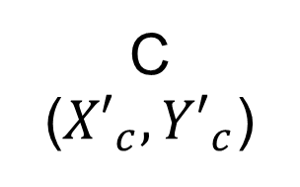
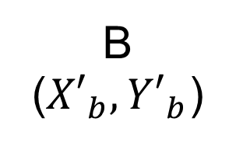
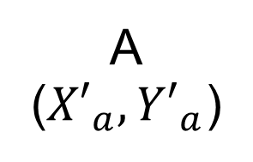

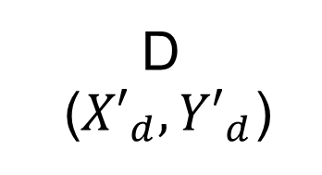
Proposed Camera View
B
(${X′}_{b},{Y′}_{b}$)
C
(${X′}_{c},{Y′}_{c}$)
Cameras are
located at
A, B, C, D
Inside the arc is the linear zone.
The angles are the vision boundaries.
Gap Exaggerated.
$$l$$
A
(${X′}_{a},{Y′}_{a}$)
D
(${X′}_{d},{Y′}_{d}$)

Slide 13
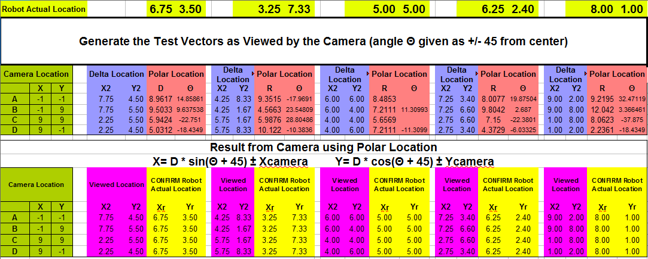
Locations, Distances & Vectors
We generated a few test vectors to verify the triangulation code.

Slide 14
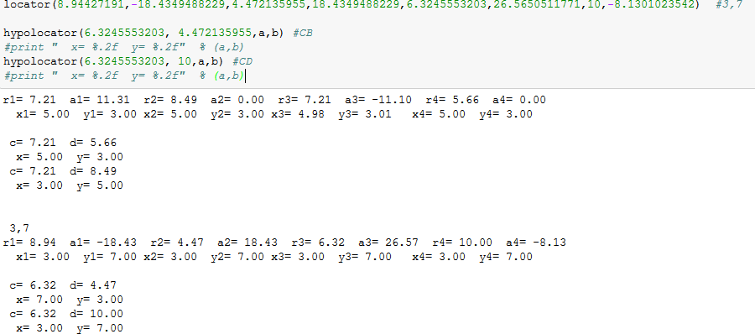
Python Code
The code expects 4 vectors and yields the Cartesian coordinates:

Slide 15
Credits & Acknowledgments
Photo Credits:
Santiago Aguerre
Caio Farias
Charles Weinthal
Huajin Qu

